Slide 1
Query Optimization: Cost Estimation
Sankhayan Choudhury
University of Calcutta

Slide 2
Cost Estimation
Cost Estimation: Join Operator
Join is the most costly operation
Cost estimation highly depends on Low level access paths. (e.g. Algorithm, Indexing etc.)

Slide 3
A typical example
Sailors (Sid, Sname, Rating, Age)
Reservers (Sid, bid, Day, Rname)
Select *
From Reserves R, Sailors S
Where R.Sid = S.Sid
Assumption for R: M pages, P_{R} tuples/ Page
Assumption for S: N pages, P_{S} tuples/ Page

Slide 4
Approaches
Enumerate all tuples in the cross product and discard those do not meet the join conditions
[Nested loop join, Block Nested loop join]
Avoid enumeration of all tuples using indexing or partitioning
[Indexed Nested loop Join, Sort-Join, Hash-join]

Slide 5
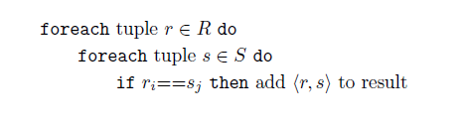
Nested loop join
Tuple at a time
Cost for join
= Cost of Scanning entire outer relation R + Cost of scanning the relation S for r times
= M pages + [ (P_{R*}M) * N] I/Os
If P_{R} = 100 & M =1000, N =500
Cost = 1000 + (100 * 500) * 1000 = 1000 + 5 * 10⁷ I/Os and in a standard configured machine it will take 140 hours [considering 10 ms for each I/O cost]

Slide 6
Page at a time: A Refinement
Uses the page oriented operation to reduce I/O cost.
For each page of R, we can retrieve each page of S and write out tuples (r,s) for all qualifying tuples r belongs to R pages and s belongs to S pages
Total cost = Scan Cost for relation R + Scan Cost for relation S = M + M.N = 1000 + 1000 * 500 = 501,000
Time needed will be 1.4 hours
Outer relation should be chosen as a smaller one.

Slide 7
Block Nested Loop Join
Page at a time approach is not using buffer pages in an effective way
Let we assume that we have sufficient memory to hold the smaller relation (R) with at least 2 extra buffer pages left over.
One buffer page is for scanning the larger relation S
Another is used for output
Total Cost = M + N I/Os = 1500 I/O s

Slide 8
Block Nested Loop Join
What will be the case where we don’t have sufficient memory to hold the entire smaller relation , say R ?
Solution:
Let we have B Buffer Page
We can use (B-2) buffer pages for outer relation R
1 buffer page for scanning S
1 buffer page for output

Slide 9
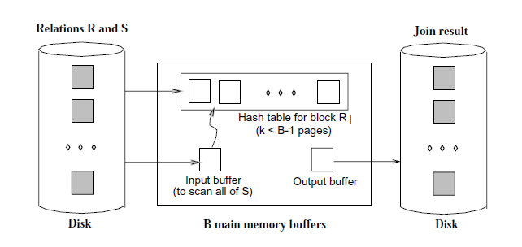
Block Nested loop Join

Slide 10
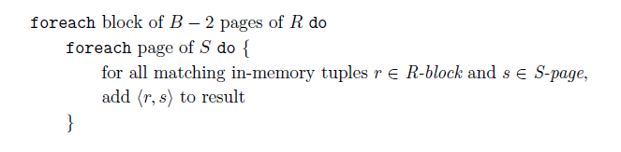
Block Nested Loop Join
Total Cost = M + (M/(B-2)) * N
Suppose we have 102 Bufferes then
cost = 1000 + (1000/100) * 500 = 6000 I/O s
If Sailor will be the outer relation,
cost = 500 + 5* 1000 = 5500 I/Os

Slide 11
Indexed Nested Loop Join
Indexed relation will be in inner loop
No need of enumerate the cross product
Cost of scanning R is M I/Os
Cost of scanning S depends on the type of index [B+ tree typically 2 to 4 I/Os, Hash Index typically 1-2 I/Os]
Moreover cost of retrieving matching tuples in S depends on the nature of index (Clustered or Non-clustered)
Sailors (Sid, Sname, Rating, Age)
Reservers (Sid, bid, Day, Rname)
Select *
From Reserves R, Sailors S
Where R.Sid = S.Sid
Assumption for R: M pages, P_{R} tuples/ Page P_{R} = 100 & M =1000, N =500
Assumption for S: N pages, P_{S} tuples/ Page

Slide 12
Cost Estimation: Indexed Nested Loop
Let we have hash based index on s_id in sailors
On an average 1. 2 I/O may be needed
Sid = Key of Sailors, No. of Matching tuple = 1
Sid is a Foreign key in Reserves; There must be one matching Sailor tuple for each R tuple.
Cost of scanning R = 1000
Total cost = 1000 + 1000* 100 * (1.2 +1) = 221,000 I/Os

Slide 13
Cost Estimation: Indexed Nested Loop
Let we have hash based index on s_id in R
We have 80* 500 sailor tuples
A sailor may have no reservation or more than one.
On an average 1. 2 I/O may be needed
Cost of scanning S = 500
Total cost = 500 + (500* 80 * (1.2)) = 48500 I/Os

Slide 14
Cost Estimation: Indexed Nested Loop
Assume there are 100000 reservations for 40,000 sailors
Assuming uniform distribution, each sailor tuple match with 2.5 R tuples.
Assume Index of R is clustered.
Matching tuples of R will be in same page for a given sailor.
40,000 extra I/O access will be needed.
If it is not clustered, in worst case it may be 2.5 * 40000
Total Cost may vary between 88, 500 and 1,48,500 I/Os.

Slide 15
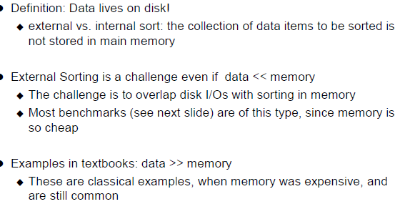
External Sorting

Slide 16
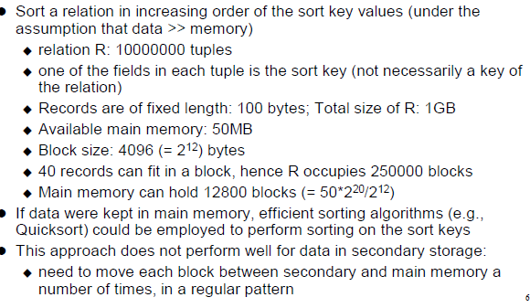
External Sorting Example

Slide 17
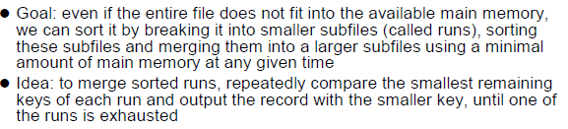
Objective: External Sorting

Slide 18
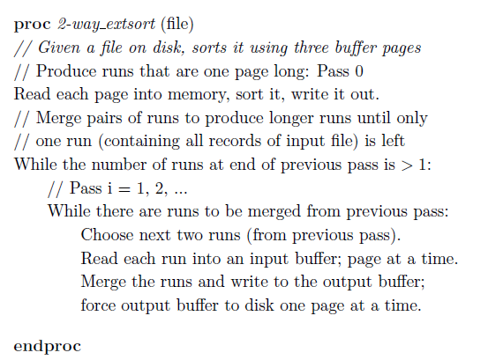
External Sorting: A two way Merge Sort

Slide 19
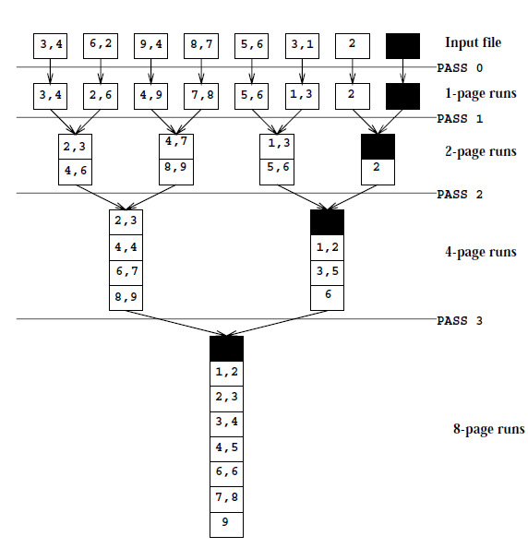
Example: Two way Merge sort of a 7 page file

Slide 20
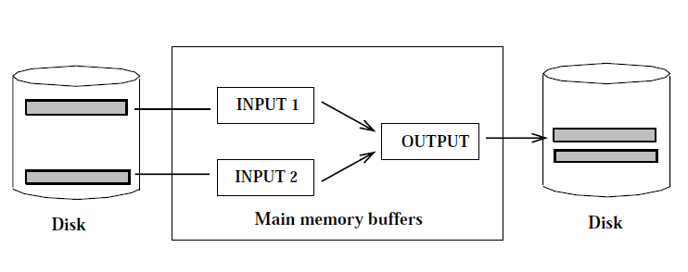
External Sorting

Slide 21
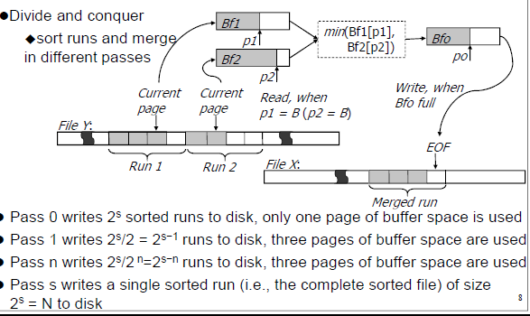
Two Way Merge Sort

Slide 22
Cost: External Sorting
Pass 0: produces 2^{K} sorted runs of 1 Pages each
Pass 1: produces 2^{K-1} sorted runs of 2 Pages each
Pass 2: produces 2^{K-2} sorted runs of 4 Pages each
Pass K: produces 1 sorted runs of 2^{K} Pages each
2 disk I/O s per Page per Pass
Number of Passes = log ₂ N + 1, N = No. of Page
Cost = 2N [(log₂ N) + 1] disk I/Os
For the given example, Cost = 2* 8 [(log₂ 8) + 1] = 64 I/Os

Slide 23
How can we improve the performance if B buffer pages are available ?

Slide 24
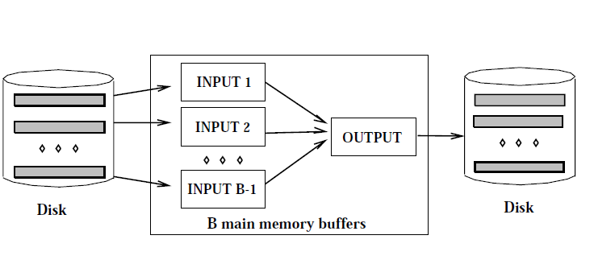
External Merge Sort

Slide 25
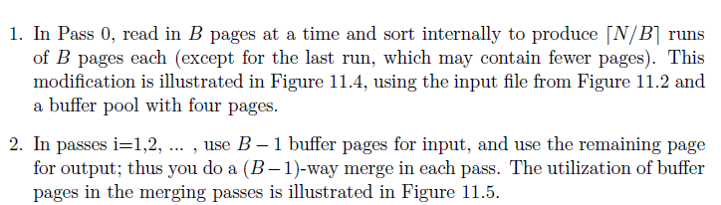
Upgradation

Slide 26
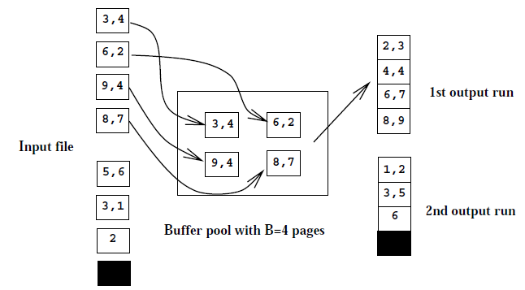
External Merge Sort: Pass 0

Slide 27
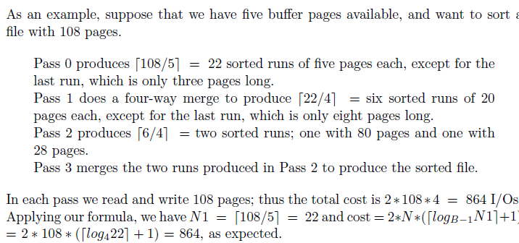
Cost Calculation

Slide 28
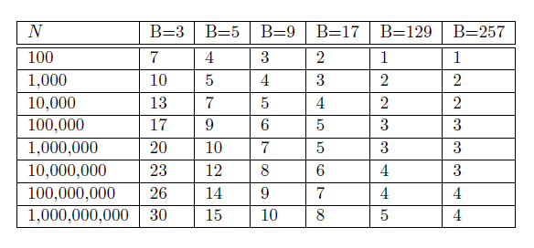
Number of Passes

Slide 29
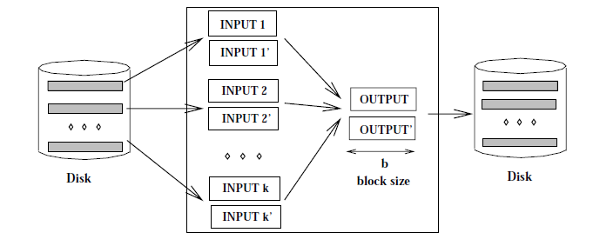
Double Buffering

Slide 30
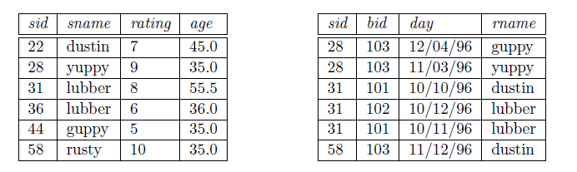
Sort Merge Join

Slide 31
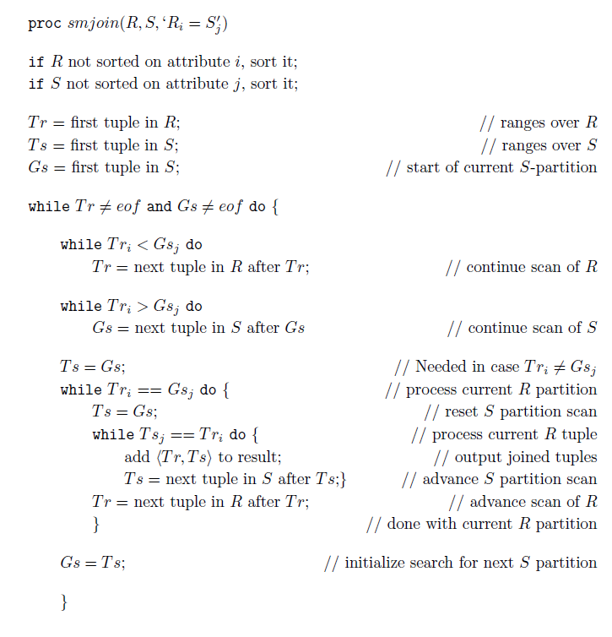
Algorithm

Slide 32
Cost Calculation
Sort Merge Join is effective if there is at least one relation sorted on join attribute
The cost of sorting R = O(Mlog M), The Cost of Sorting S = O(N log N), Cost of merging = (M+N)
For our example assuming B= 100
cost to sort R = 2* 1000* log₁₀₀ 1000 = 4000
cost to sort S = 2* 500 * log₁₀₀ 500 = 2000
Total cost = 4000 + 2000 + (1000 + 500) = 7500 I/Os

Slide 33
Hash Join
Hash join uses hashing for doing partition (partitioning phase)
In probing phase compare the tuples of a partition of R table to the corresponding partition of S table
Avoid the enumeration

Slide 34
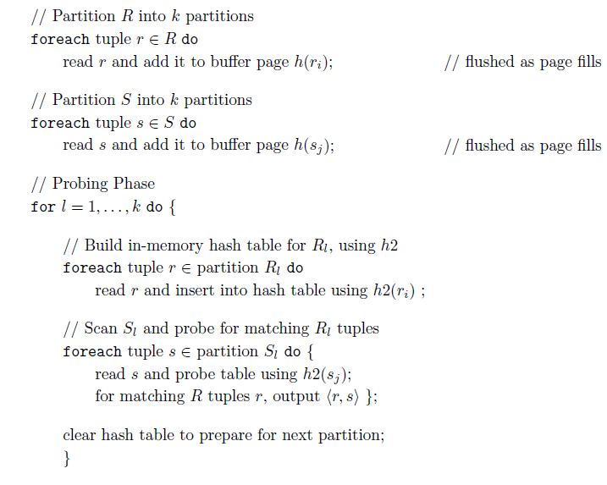
Hash based Join

Slide 35
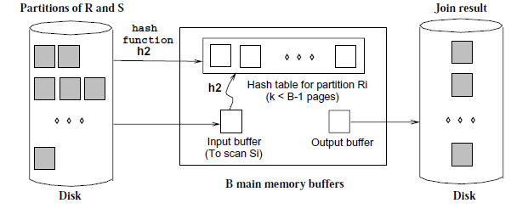
Probing Phase

Slide 36
Cost : Hash based Join
Partitioning Phase
Need to scan R & S once and write them both; cost = 2 (M+N)
For Probing Phase (assuming no overflow in partition) cost = M+N
Total cost = 3 (M+N)
For our example : 3(1000+500) = 4500 I/O that may take less than 1 min.

Slide 37
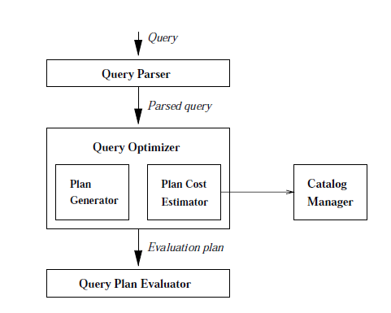
A typical Query Optimizer

Slide 38
Example
Sailors (Sid, Sname, Rating, Age)
Reservers (Sid, bid, Day, Rname)
Legth of each tuple in R & S are 40 and 50 bytes respectively.
One page contains 100 R / 80 S tuples
We have 1000 pages of R and 500 pages of S tuples

Slide 39
Working principle: Optimizer
Enumerate a subset of all possible plans for enumerate the expression
Estimate the cost of each enumerated plan
Choose the cheapest one
Practically a plan becomes a query tree (RA expression) annotated with the access path for each operation as well as the method of implementation for the corresponding operator

Slide 40
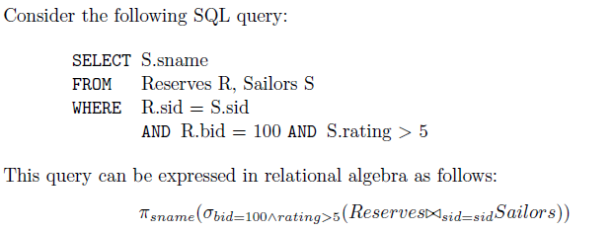
A Running Example

Slide 41
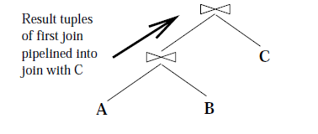
Pipelined Vs. Materialization
In materialization the output of an operation is stored in an intermediate table; the pipeline performs better in terms of overhead

Slide 42
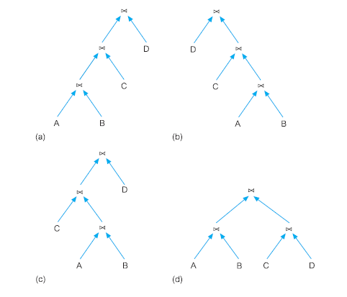
Linear & Bushy trees

Slide 43
Left Deep Plans
In Linear Tree, at least one child of a join node will be a base table.
Optimizers typically use only left deep plans
As the no of join increases, the no of alternative plans increases rapidly and it becomes necessary to prove the space of alternative plans.
Left deep trees allow us to generate all fully pipelined plans. (as inner relations are always base relations)

Slide 44
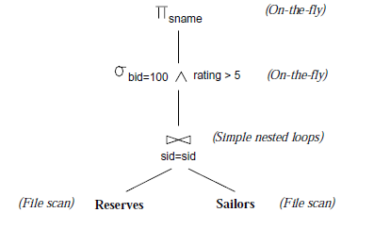
A Running Example
Outer relation is the left child of the join operator: convention used

Slide 45
A Running Example
Outer relation is the left child of the join operator: convention used
Cost = Cost of nested loop join = 1000 + 1000 * 500 = 5,01,000 I/O s

Slide 46
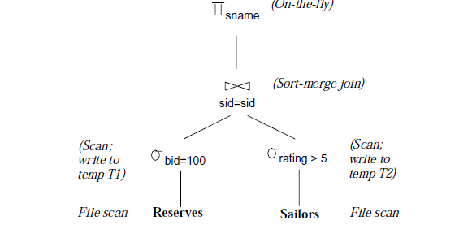
An improved Tree
5 Buffer Pages are available; Ratings are uniformly distributed over the range 1 to 10; 100 boats are there and Reservations are spread uniformly across all boats; T1 = 10; T2=250; sort Merge = cost for sorting + cost for merging = (2*10*2) + (2*250*4) + (10+250) = 2300 ; Selection = 1000 +10+500+250 = 1760
Total cost = 4060 I/Os

Slide 47
Alternate Plans
Alternate 1
Use Block Nested loop instead of Sort Merge
For every 3 page Block we scan T2
T2 need to be scanned 4 times
Join cost = 10 + 4 * 250 = 1010
Total Cost = Selection cost + Join Cost = (1760) + (1010) = 2770 I/O s

Slide 48
Alternate Plans
Pushing Projection
Only sid from T1 and Sid, Sname from T2 will be needed
T1 may fit within 3 buffer pages
1 scan of T2 will be needed
Total cost = 1760 + 250 = 2010 I/Os

Slide 49
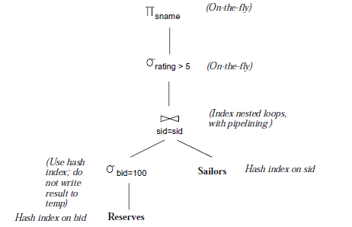
Alternate plans
Clustered static hash index on bid, hash index on sid, to locate the selection 10 I/O needed as we asume there are 100 boats thus on an average each boat have 10 reservations, standard selection for hash index will be 1.2 Thus total cost = 10 + 1000 * 1.2 = 1210 I/O

Slide 50
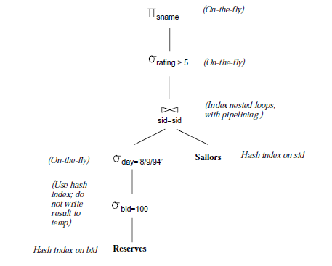
Alternative Plans
The clever use of pushing selection & Indexing made the join trivial. Cost = 10 + 1.2 = 11.2 I/Os

Slide 51
Physical Database Tuning
Depends on Database Workloads
A list of queries and their frequencies, as a ratio of all queries and updates. (Which relations are accessed; Which attributes are retained (in the SELECT clause);Which attributes have selection or join conditions expressed on them (in the WHERE clause) and how selective these conditions are likely to be
A list of updates and their frequencies. (The type of update (INSERT, DELETE, or UPDATE) and the updated relation. For UPDATE commands, the fields that are modified by the update)
Performance goals for each type of query and update

Slide 52
Tuning Decisions
Which indexes to create?
Which relations to index and which field or combination of fields to choose as index search keys.
For each index, should it be clustered or unclustered?
Whether we should make changes to the conceptual schema in order to enhance performance?
Alternative conceptual Schema, De-normalization, Vertical partitioning, Views
Frequently executed queries and transactions might be re-written to run faster

Slide 53
Index Selection Guideline
Don’t build an index unless some query—including the query components of updates— will benefit from it. Whenever possible, choose indexes that speed up more than one query.
Attributes mentioned in a WHERE clause are candidates for indexing
An exact-match selection condition suggests that we should consider an index on the selected attributes, ideally, a hash index.
A range selection condition suggests that we should consider a B+ tree (or ISAM) index on the selected attributes

Slide 54
Index Selection Guideline
Multiple-attribute search keys:
A WHERE clause includes conditions on more than one attribute of a relation
They enable index-only evaluation strategies (i.e., accessing the relation can be avoided) for important queries.
Whether to cluster? At most one index on a given relation can be clustered, and clustering affects performance greatly; so the choice of clustered index is important
range queries are likely to benefit the most from clustering.
If an index enables an index-only evaluation strategy for the query it is intended to speed up, the index need not be clustered. Clustering matters only when the index is used to retrieve tuples from the underlying relation.

Slide 55
Index Selection Guideline
Balancing the cost of index maintenance
If maintaining an index slows down frequent update operations, consider dropping the index.
Adding an index may well speed up a given update operation. For example, an index on employee ids could speed up the operation of increasing the salary of a given employee (specified by id)

Slide 56
Index Selection Guideline
Hash versus tree index
A B+ tree index is usually preferable because it supports range queries as well as equality queries.
A hash index is better in the following situations:
The index is intended to support index nested loops join; the indexed relation is the inner relation, and the search key includes the join columns. In this case, the slight improvement of a hash index over a B+ tree for equality selections is magnified, because an equality selection is generated for each tuple in the outer relation.
There is a very important equality query, and there are no range queries, involving the search key attributes

Slide 57
Example
SELECT E.ename, D.mgr
FROM Employees E, Departments D
WHERE D.dname=‘Toy’ AND E.dno=D.dno
First predicate checks an equality condition;
Hash based index should be maintained on dname within Department relation
For each qualifying Departments tuple, we find matching Employees tuples by using an index on the dno attribute of Employees. Thus, we should build an index on the dno field of Employees

Slide 58
Example
SELECT E.ename, D.mgr
FROM Employees E, Departments D
WHERE D.dname=‘Toy’ AND E.dno=D.dno AND E.age = 25
plan is to retrieve Departments tuples that satisfy the selection on dname and to retrieve matching Employees tuples by using an index on the dno field; the selection on age is then applied on-the-fly.
Alternative (assuming there is an index on age for Employee): we can retrieve Departments tuples that satisfy the selection on dname (by using the index on dname, as before), retrieve Employees tuples that satisfy the selection on age by using the index on age, and join these sets of tuples. Since the sets of tuples we join are small, they fit in memory and the join method is not important.

Slide 59
Examples of Clustering
B+ tree index on E.age can be used to get qualifying tuples.
How selective is the condition?
Is the index clustered?
Consider the GROUP BY query.
If many tuples have E.age > 10, using E.age index and sorting the retrieved tuples may be costly.
Clustered E.dno index may be better!
Equality queries and duplicates:
Clustering on E.hobby helps!
SELECT E.dno
FROM Emp E
WHERE E.age>40
SELECT E.dno, COUNT (*)
FROM Emp E
WHERE E.age>10
GROUP BY E.dno
SELECT E.dno
FROM Emp E
WHERE E.hobby=Stamps
Notes:
18

Slide 60
Clustering and Joins
SELECT E.ename, D.mgr
FROM Emp E, Dept D
WHERE D.dname=‘Toy’ AND E.dno=D.dno
Clustering is especially important when accessing inner tuples in INL.
Should make index on E.dno clustered.
Suppose that the WHERE clause is instead:
WHERE E.hobby=‘Stamps AND E.dno=D.dno
If many employees collect stamps, Sort-Merge join may be worth considering. A clustered B + tree index on D.dno would help.
Summary: Clustering is useful whenever many tuples are to be retrieved.
Notes:
19

Slide 61
Multi-Attribute Index Keys
To retrieve Emp records with age=30 AND sal=4000, an index on <age,sal> would be better than an index on age or an index on sal.
Such indexes also called composite or concatenated indexes.
Choice of index key orthogonal to clustering etc.
If condition is: 20<age<30 AND 3000<sal<5000:
Clustered tree index on <age,sal> or <sal,age> is best.
If condition is: age=30 AND 3000<sal<5000:
Clustered <age,sal> index much better than <sal,age> index!
Composite indexes are larger, updated more often.
Notes:
20

Slide 62
Index-Only Plans
SELECT D.mgr
FROM Dept D, Emp E
WHERE D.dno=E.dno
<E.dno>
A number of queries can be answered without retrieving any tuples from one or more of the relations involved if a suitable index is available.
SELECT D.mgr, E.eid
FROM Dept D, Emp E
WHERE D.dno=E.dno
<E.dno,E.eid>
Tree index!
SELECT E.dno, COUNT(*)
FROM Emp E
GROUP BY E.dno
<E.dno>
SELECT E.dno, MIN(E.sal)
FROM Emp E
GROUP BY E.dno
<E.dno,E.sal>
Tree index!
<E. age,E.sal>
or
<E.sal, E.age>
SELECT AVG(E.sal)
FROM Emp E
WHERE E.age=25 AND
E.sal BETWEEN 3000 AND 5000
Tree!
Notes:
21

Slide 63
Tuning the Conceptual Schema
The choice of conceptual schema should be guided by the workload, in addition to redundancy issues:
We may settle for a 3NF schema rather than BCNF.
Workload may influence the choice we make in decomposing a relation into 3NF or BCNF.
We may further decompose a BCNF schema!
We might denormalize (i.e., undo a decomposition step), or we might add fields to a relation.
We might consider horizontal decompositions.
If such changes are made after a database is in use, called schema evolution; might want to mask some of these changes from applications by defining views.
Notes:
23

Slide 64
Example Schemas
Contracts (Cid, Sid, Jid, Did, Pid, Qty, Val)
Depts (Did, Budget, Report)
Suppliers (Sid, Address)
Parts (Pid, Cost)
Projects (Jid, Mgr)
We will concentrate on Contracts, denoted as CSJDPQV. The following integrity constraints are given to hold: JP → C, SD → P, C is the primary key.
What are the candidate keys for CSJDPQV?
What normal form is this relation schema in?
Notes:
24

Slide 65
Settling for 3NF vs BCNF
CSJDPQV can be decomposed into SDP and CSJDQV, and both relations are in BCNF. (Which FD suggests that we do this?)
Lossless decomposition, but not dependency-preserving.
Adding CJP makes it dependency-preserving as well.
Suppose that this query is very important:
Find the number of copies Q of part P ordered in contract C.
Requires a join on the decomposed schema CJP and CSJDQV, but can be answered by a scan of the original relation CSJDPQV.
Could lead us to settle for the 3NF schema CSJDPQV.
Notes:
25

Slide 66
Denormalization
Suppose that the following query is important:
Is the value of a contract less than the budget of the department?
To speed up this query, we might add a field budget B to Contracts.
This introduces the FD D → B wrt Contracts.
Thus, Contracts is no longer in 3NF.
We might choose to modify Contracts despite this if the query is sufficiently important, and we cannot obtain adequate performance otherwise (i.e., by adding indexes or by choosing an alternative 3NF schema.)
Notes:
26

Slide 67
Choice of Decompositions
There are 2 ways to decompose CSJDPQV into BCNF:
SDP and CSJDQV; lossless-join but not dep-preserving.
SDP, CSJDQV and CJP; dep-preserving as well.
The difference between these is really the cost of enforcing the FD JP → C.
2nd decomposition: Index on JP on relation CJP.
1st:
CREATE ASSERTION CheckDep CHECK
( NOT EXISTS ( SELECT * FROM PartInfo P, ContractInfo C
WHERE P.sid=C.sid AND P.did=C.did
GROUP BY C.jid, P.pid
HAVING COUNT (C.cid) > 1 ))
Notes:
27

Slide 68
Choice of Decompositions (Contd.)
The following FDs were given to hold: JP → C, SD → P, C is the primary key.
Suppose that, in addition, a given supplier always charges the same price for a given part: SPQ → V.
If we decide that we want to decompose CSJDPQV into BCNF, we now have a third choice:
Begin by decomposing it into SPQV and CSJDPQ.
Then, decompose CSJDPQ (not in 3NF) into SDP, CSJDQ.
This gives us the lossless-join decomp: SPQV, SDP, CSJDQ.
To preserve JP → C, we can add CJP, as before.
Choice: { SPQV, SDP, CSJDQ } or { SDP, CSJDQV } ?
Notes:
28

Slide 69
Decomposition of a BCNF Relation
Suppose that we choose { SDP, CSJDQV }. This is in BCNF, and there is no reason to decompose further (assuming that all known integrity constraints are FDs).
However, suppose that these queries are important:
Find the contracts held by supplier S.
Find the contracts that department D is involved in.
Decomposing CSJDQV further into CS, CD and CJQV could speed up these queries. (Why?)
On the other hand, the following query is slower:
Find the total value of all contracts held by supplier S.
Notes:
14

Slide 70
Horizontal Decompositions
Our definition of decomposition, so far: Relation is replaced by a collection of relations that are projections. This is vertical decomposition. Most important case.
Sometimes, might want to replace relation by a collection of relations that are selections. This is horizontal decomposition.
Each new relation has same schema as the original, but a subset of the rows.
Collectively, new relations contain all rows of the original. Typically, the new relations are disjoint.
Notes:
15

Slide 71
Horizontal Decompositions (Contd.)
Suppose that contracts with value > 10000 are subject to different rules. This means that queries on Contracts will often contain the condition val>10000.
One way to deal with this is to build a clustered B+ tree index on the val field of Contracts.
A second approach is to replace contracts by two new relations: LargeContracts and SmallContracts, with the same attributes (CSJDPQV).
Performs like index on such queries, but no index overhead.
Can build clustered indexes on other attributes, in addition!
Notes:
16

Slide 72
Masking Conceptual Schema Changes
CREATE VIEW Contracts(cid, sid, jid, did, pid, qty, val)
AS SELECT *
FROM LargeContracts
UNION
SELECT *
FROM SmallContracts
The replacement of Contracts by LargeContracts and SmallContracts can be masked by the view.
However, queries with the condition val>10000 must be asked wrt LargeContracts for efficient execution: so users concerned with performance have to be aware of the change.
Notes:
17

Slide 73
Tuning Queries and Views
If a query runs slower than expected, check if an index needs to be re-built, or if statistics are too old.
Sometimes, the DBMS may not be executing the plan you had in mind. Common areas of weakness:
Selections involving null values.
Selections involving arithmetic or string expressions.
Selections involving OR conditions.
Lack of evaluation features like index-only strategies or certain join methods or poor size estimation.
Check the plan that is being used! Then adjust the choice of indexes or rewrite the query/view.
Notes:
18

Slide 74
Rewriting SQL Queries
Complicated by interaction of:
NULLs, duplicates, aggregation, subqueries.
Guideline: Use only one “query block”, if possible.
SELECT DISTINCT *
FROM Sailors S
WHERE S.sname IN
(SELECT Y.sname
FROM YoungSailors Y)
SELECT DISTINCT S.*
FROM Sailors S,
YoungSailors Y
WHERE S.sname = Y.sname
=
Not always possible ...
SELECT *
FROM Sailors S
WHERE S.sname IN
(SELECT DISTINCT Y.sname
FROM YoungSailors Y)
=
SELECT S.*
FROM Sailors S,
YoungSailors Y
WHERE S.sname = Y.sname

Slide 75
The Notorious COUNT Bug
SELECT dname FROM Department D
WHERE D.num_emps >
(SELECT COUNT(*) FROM Employee E
WHERE D.building = E.building)
CREATE VIEW Temp (empcount, building) AS
SELECT COUNT(*), E.building
FROM Employee E
GROUP BY E.building
SELECT dname
FROM Department D,Temp
WHERE D.building = Temp.building
AND D.num_emps > Temp.empcount;
What happens when Employee is empty??

Slide 76
Summary on Unnesting Queries
DISTINCT at top level: Can ignore duplicates.
Can sometimes infer DISTINCT at top level! (e.g. subquery clause matches at most one tuple)
DISTINCT in subquery w/o DISTINCT at top: Hard to convert.
Subqueries inside OR: Hard to convert.
ALL subqueries: Hard to convert.
EXISTS and ANY are just like IN.
Aggregates in subqueries: Tricky.
Good news: Some systems now rewrite under the covers (e.g. DB2).

Slide 77
More Guidelines for Query Tuning
Minimize the use of DISTINCT: don’t need it if duplicates are acceptable, or if answer contains a key.
Minimize the use of GROUP BY and HAVING:
SELECT MIN (E.age)
FROM Employee E
GROUP BY E.dno
HAVING E.dno=102
SELECT MIN (E.age)
FROM Employee E
WHERE E.dno=102
Consider DBMS use of index when writing arithmetic expressions: E.age=2*D.age will benefit from index on E.age, but might not benefit from index on D.age!
Notes:
19

Slide 78
Guidelines for Query Tuning (Contd.)
SELECT E.dno, AVG(E.sal)
FROM Emp E, Dept D
WHERE E.dno=D.dno
AND D.mgrname=‘Joe’
GROUP BY E.dno
Avoid using intermediate relations:
SELECT * INTO Temp
FROM Emp E, Dept D
WHERE E.dno=D.dno
AND D.mgrname=‘Joe’
SELECT T.dno, AVG(T.sal)
FROM Temp T
GROUP BY T.dno
vs.
and
Does not materialize the intermediate reln Temp.
If there is a dense B+ tree index on <dno, sal>, an index-only plan can be used to avoid retrieving Emp tuples in the first query!
Notes:
20

